Slide 1

Customer Shopping Behavior Analysis
This project analyzes customer shopping behavior using transactional data from 3,900 purchases across various product categories. The goal is to uncover insights into spending patterns, customer segments, product preferences, and subscription behavior to guide strategic business decisions.

Slide 2
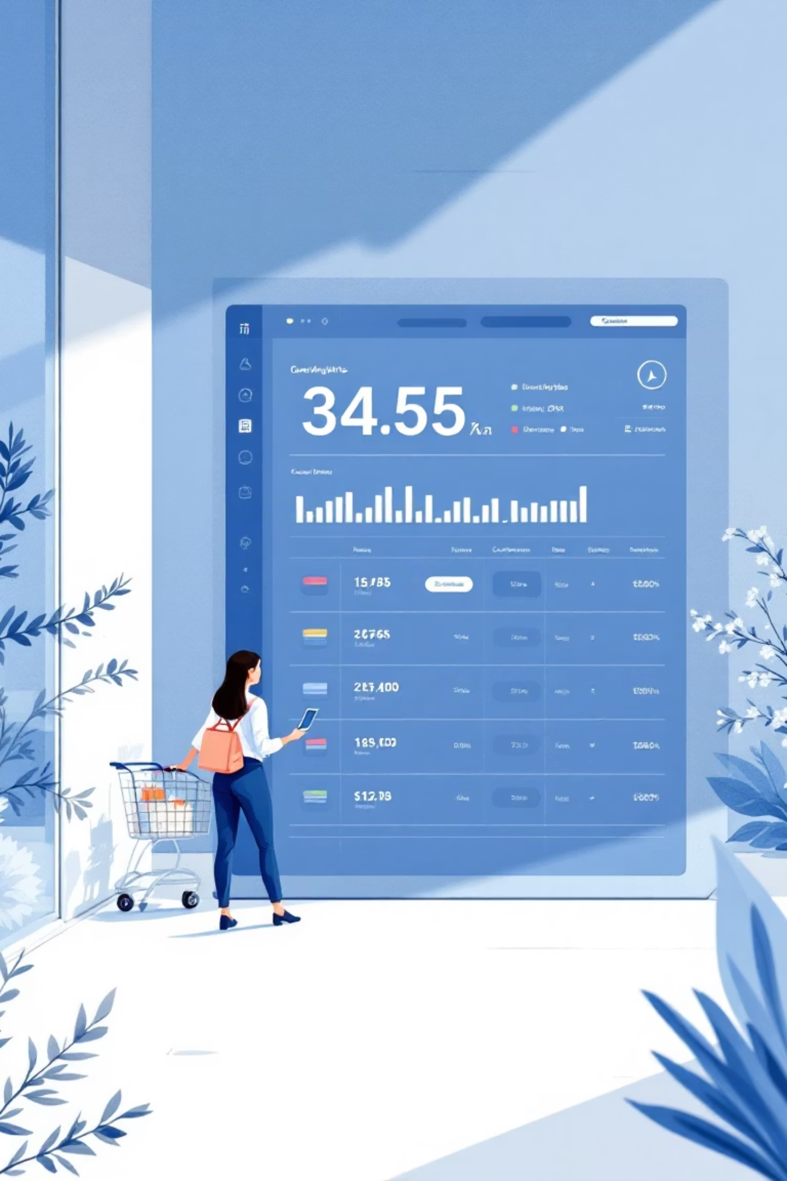
Dataset Overview
3,900
18
50
Total Purchases
Data Features
Product Categories
Transactions analyzed across all categories
Comprehensive customer and purchase attributes
Diverse range of items tracked
37
Missing Values
Only in Review Rating column
The dataset includes customer demographics (Age, Gender, Location, Subscription Status), purchase details (Item Purchased, Category, Purchase Amount, Season, Size, Color), and shopping behavior metrics (Discount Applied, Promo Code Used, Previous Purchases, Review Rating, Shipping Type).

Slide 3
Data Preparation & Analysis Process
01
02
03
Data Loading & Exploration
Data Cleaning
Feature Engineering
Imported dataset using pandas and performed initial exploration with df.info() and df.describe() to understand structure and summary statistics.
Handled missing values by imputing Review Rating column with median ratings per product category. Standardized column names to snake case.
Created age_group column by binning customer ages and purchase_frequency_days column for purchase data analysis.
04
05
Data Consistency
Database Integration
Verified redundancy between discount_applied and promo_code_used fields, then dropped promo_code_used for cleaner analysis.
Connected Python script to PostgreSQL and loaded cleaned DataFrame into database for structured SQL analysis.

Slide 4
Key Business Insights from SQL Analysis
Revenue by Gender
Shipping Preferences
Male customers generated $157,890 in revenue compared to $75,191 from female customers, indicating a significant gender-based spending difference.
Express shipping users spent an average of $60.48 vs. $58.46 for Standard shipping, suggesting premium service attracts higher spenders.
High-Spending Discount Users
Subscription Impact
Identified 839 customers who used discounts but still spent above average purchase amounts, representing valuable price-sensitive yet high-value shoppers.
1,053 subscribers generated $62,645 in revenue with average spend of $59.49, while 2,847 non-subscribers contributed $170,436 with $59.87 average spend.
Top-Rated Products
Discount Dependency
Gloves (3.86), Sandals (3.84), and Boots (3.82) received the highest average review ratings, indicating strong customer satisfaction.
Hats (50%), Sneakers (49%), and Coats (49%) showed highest discount usage rates, indicating price sensitivity for these categories.

Slide 5
Customer Segmentation & Product Performance
Loyal Customers
Returning Customers
New Customers
3,116 customers (80% of base)
701 customers (18% of base)
83 customers (2% of base)
Highest value segment with consistent purchase history
Growth opportunity segment showing repeat behavior
Fresh acquisition requiring nurturing strategies
Top Products by Category
Accessories
Clothing
Footwear
Jewelry (171 orders)
Blouse (171 orders)
Sandals (160 orders)
Sunglasses (161)
Pants (171)
Shoes (150)
Belt (161)
Shirt (169)
Sneakers (145)
Repeat buyers with more than 5 purchases showed strong subscription correlation: 958 subscribers vs. 2,518 non-subscribers, suggesting loyalty programs drive subscription adoption.

Slide 6
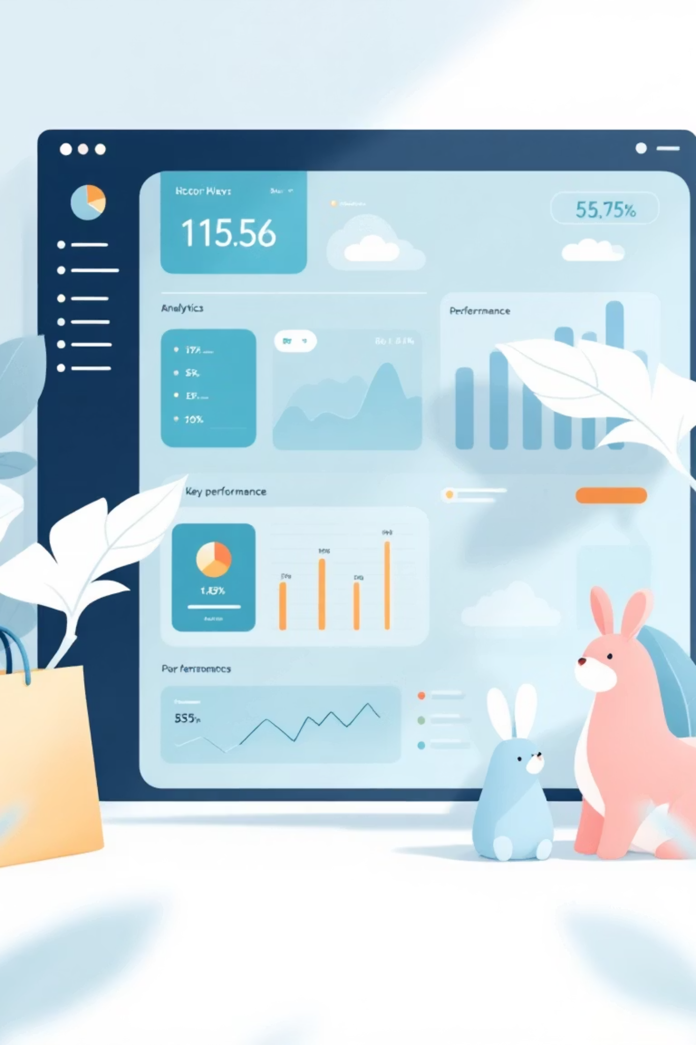
Dashboard Insights & Key Metrics
$59.67
80%
$150K
Avg. Purchase
Customer Retention
Top Category Revenue
Overall average transaction value per customer.
Percentage of repeat customers over time.
Revenue from the highest-performing product category.
3.5%
$65
Conversion Rate
Avg. Order Value
Percentage of visitors completing a purchase.
Mean total value of each customer order.

Slide 7
Strategic Business Recommendations
Boost Subscription Programs
Implement Customer Loyalty Programs
Optimize Discount Strategy
Promote exclusive benefits for subscribers to convert the large non-subscriber base. Focus on the 2,518 repeat buyers who haven't yet subscribed.
Review discount policy to balance sales boosts with margin control. Focus discounts on high-dependency products like Hats and Sneakers while protecting margins on premium items.
Reward repeat buyers to accelerate their transition into the "Loyal" segment. Target the 701 returning customers with personalized incentives.
Enhance Product Positioning
Execute Targeted Marketing
Highlight top-rated products (Gloves, Sandals, Boots) and best-sellers (Jewelry, Blouses, Pants) in marketing campaigns to drive conversion.
Focus efforts on high-revenue age groups and express shipping users who demonstrate higher spending patterns. Develop gender-specific campaigns given the revenue disparity.

